Slide 1
Ensuring the sustainability of the Savings and Investment Industry for growth
27 October 2021
Notes:
Observe protocol

Slide 2
Content
About NaSIA
Members
The Savings and Investment Industry, an overview
Ensuring the sustainability of the Savings and Investment Industry for growth
Economic recovery (vaccination drive)
Conclusion
Notes:
Public policy advocacy-
Financial Sector Development-
Social and Skills development-
Introduce Malcolm
NaSIA is privileged to have access to the best technical experts in our industry. At this juncture I’d like to introduce Malcolm Husselmann.
Financial sector development pillar
Ensure enabling framework, markets and instruments
Social and skills development
Ensure skills development to staff of members
Foster knowledge and competence for the industry
Facilitate transformation

Slide 3
About NaSIA
Represents the majority of the country's Asset Managers, Collective Investment Scheme (CIS) management companies, Linked Investment Service Providers (LISPs) and life insurance companies.
Formed in 2017 by members of the Association for Unit Trusts in Namibia (AUTN), the Investment Managers Association of Namibia (IMAN) and the Life Assurers Association of Namibia (LAAN). These associations disbanded and their assets and activities were transferred to NaSIA.
NaSIA enables the non-banking sector to speak with one voice and represents the unified goal of ensuring that the Namibian savings and investment industry remains relevant and sustainable into the future in the interest of not only of NaSIA and its members, but also the country and its citizens.
NaSIA is incorporated as a not-for profit company and is empowered by a mandate from an industry that is considered a formidable partner around Government’s negotiation table where we proactively engage on policy, regulatory and issues of common concern.

Slide 4
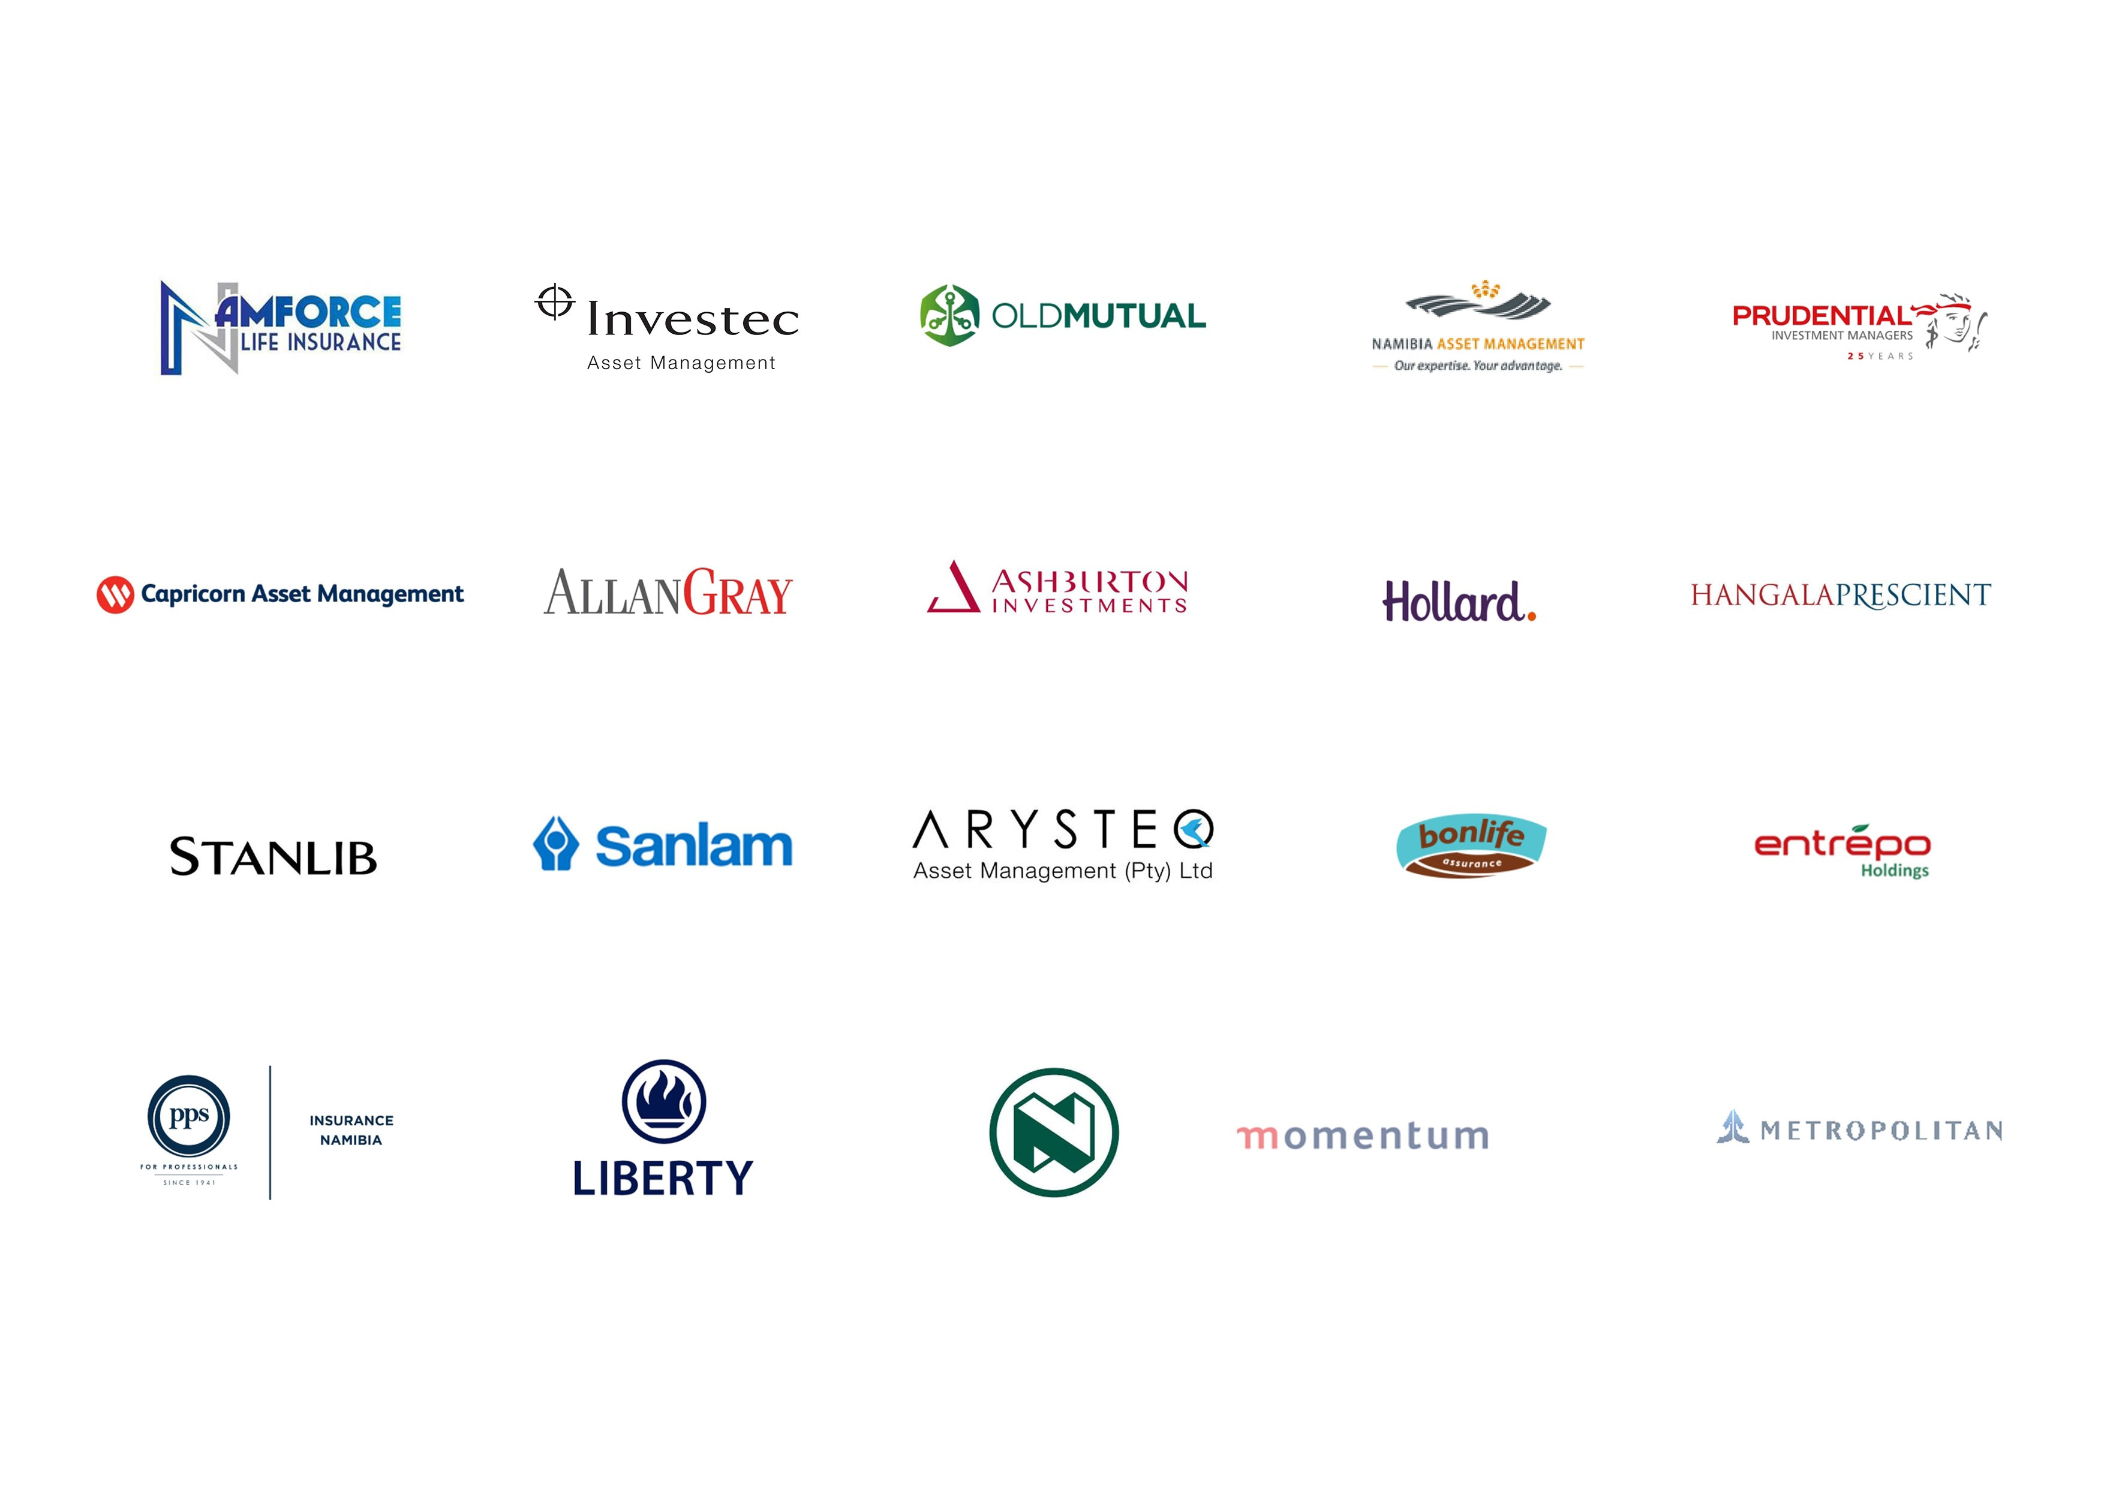
Members
NaSIA's members are considered the custodian of the bulk of the nation's savings and investments (i.e. the non-banking sector) and are among the country's biggest contributors to the national GDP.

Slide 5
The Savings and Investment Industry, an overview
The assets of the Non-bank Financial Institutions Sector (NBFI) grew by 4.59 percent from N$341.9 billion in 2020 (Q4) to N$357.6 billion in 2021 (Q1), despite the continued recessionary conditions, worsened by COVID-19 during 2020 and 2021, thanks to the stellar performance of the equity markets.
NaSIA members accounts for N$ 256.04 billion (71.6%) of that amount.
Historic timeline of regulatory changes:
FIMA gazetted

Slide 6
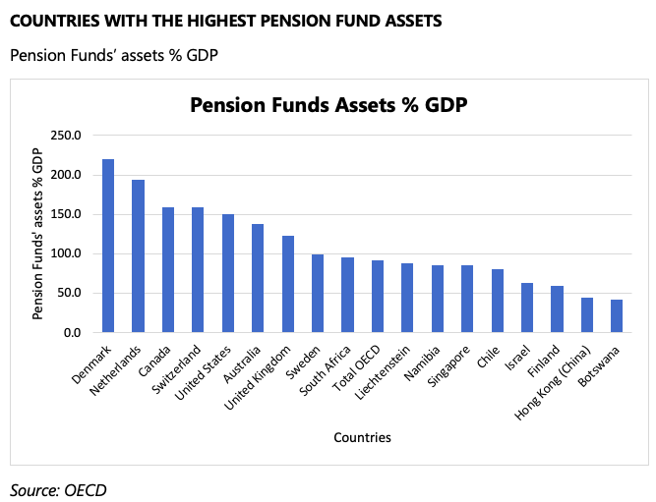
The Savings and Investment Industry, an overview
Namibia has one of the highest relative contractual saving pools in the world.

Slide 7
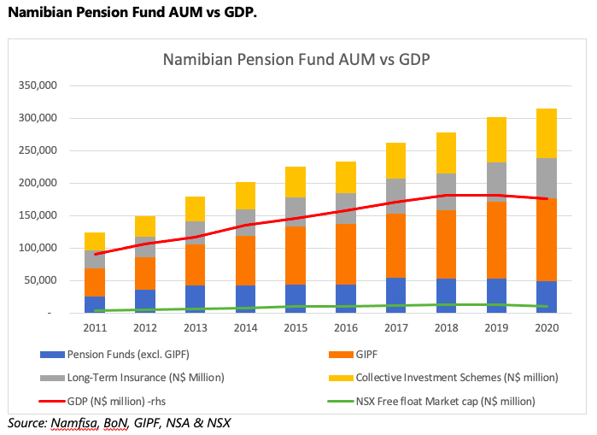
Ensuring the sustainability of the Savings and Investment Industry for growth
Asset allocation should be in the best interest of the saver (best returns)
Stark disparity between the sizes of the savings pool and local stock market capitalisation in Namibia

Slide 8
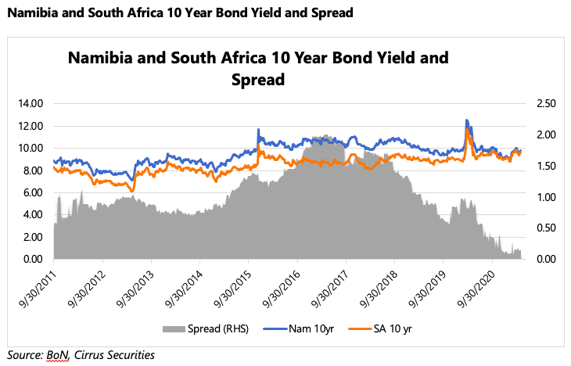
Ensuring the sustainability of the Savings and Investment Industry for growth
Decline in spreads on the Namibian 10-year government bond yield over its South African counterparts’ bond yield since 2018, when Namibian pension funds were required to fully comply with the 45% local asset requirement.
Future bond auctions may be met with wanning demand

Slide 9
Ensuring the sustainability of the Savings and Investment Industry for growth
Our role
Engagements with the Ministry of Finance on a wide range of issues, particularly:
NaSIA submission to propose amendments to the income tax act, 1981, in relation to income levels payable on living annuities as well as other retirement related concerns (submitted on 23 october 2020);
NaSIA welcomes the announcement by the Minister of Finance, Hon. Ipumbu Shiimi, during his budget speech on 17 March 2021, to increase the deductibility of pension fund and educational policies contributions from the current N$40,000 to a maximum of N$150,000, in order to encourage savings for retirement purpose. Special mention of NaSIA was made. NaSIA is currently working with the ministry of finance to implement this change.
NaSIA submission on the proposed amendments to the value added tax act to introduce 15% VAT on Asset Management Fees (submitted on 10 September 2021)
Justification to “level playing field” not sufficient;
Impact on returns;
Unlisted Asset Managers are compelled by law to invest in the country whereas Listed Asset Managers have the freedom (discretion) to invest outside the country subject to the specific mandate of client.
NaSIA Advisory Note on Asset Allocation (submitted on 13 October 2021)
Allow professional capital allocators the flexibility to structure their portfolio in the best interest of the investors/savers ;
Improve diversification options within the market: Encourage local entities to list through various incentives (tax and otherwise) and list viable Public Enterprises where suitable;
Encourage foreign capital to flow into the Namibian local currency debt space by fast tracking the implementation of the CSD (digital trading and settlement of bonds).
Nasia advisory note on the economy (submitted on 12 november 2020):
Public Service wage bill
PSEMAS

Slide 10
Ensuring the sustainability of the Savings and Investment Industry for growth
Our role
Engagements with NAMFISA:
FIMA. 9-12 months of formal consultations;
Critical standards to be gazetted;
Busy period ahead.
Engagements with NIPDP:
NEEEF/B –on the transformation of the industry;
Namibia Financial Sector Charter.
Collaborations:
FLI- on financial literacy. Specialized content;
Start-up Namibia: to create a culture of entrepreneurship by supporting pitch events.

Slide 11
Vaccines for Hope Financial Summary
Vaccines for Hope: allocation and spend of funds as at 6 October 2021
N$12.18 million raised in donations
N$8.77 million allocated to date, of which N$ 7.96 million spent
N$3.40 million left to allocate

Slide 12
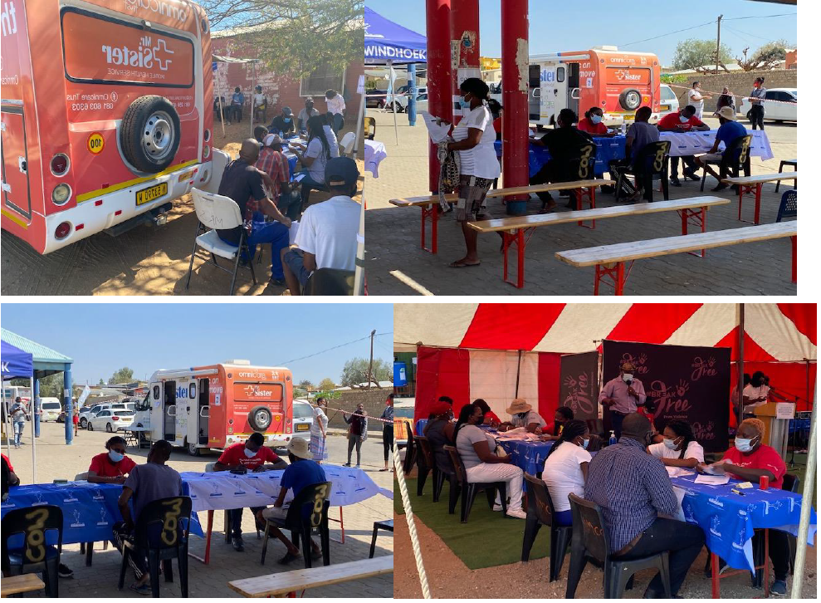
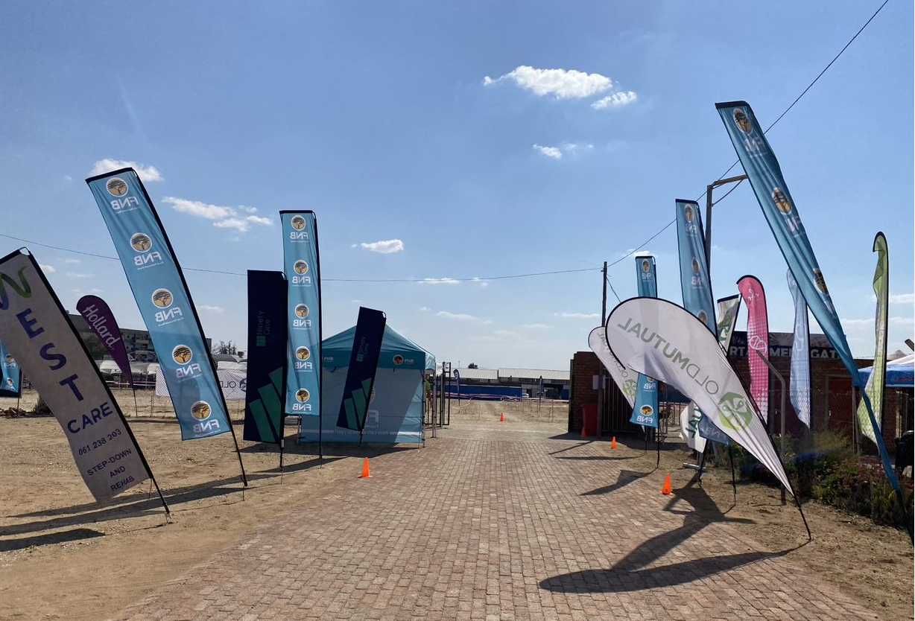
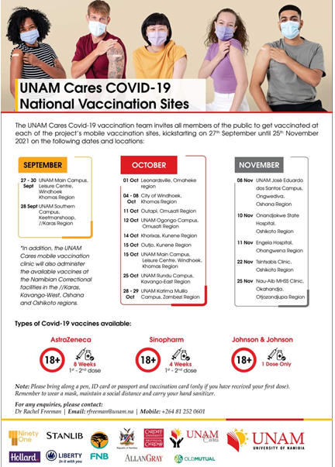
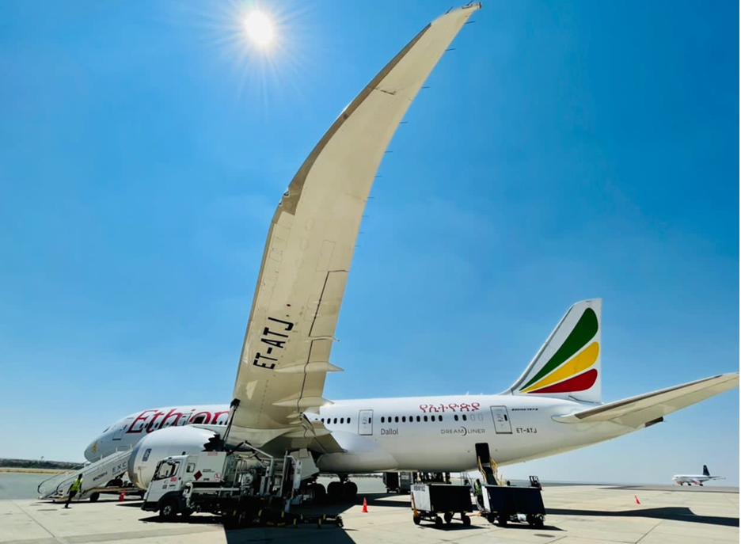
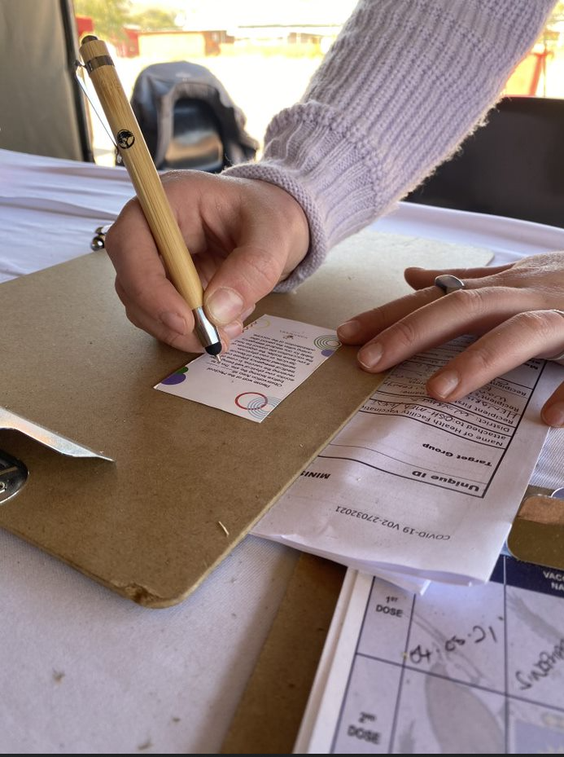
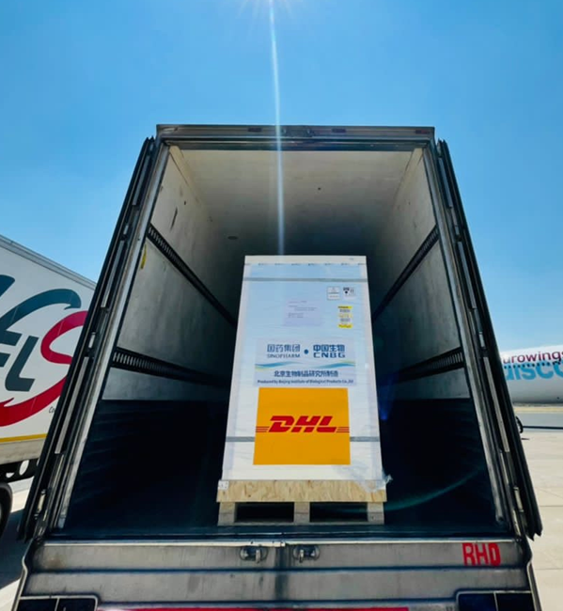
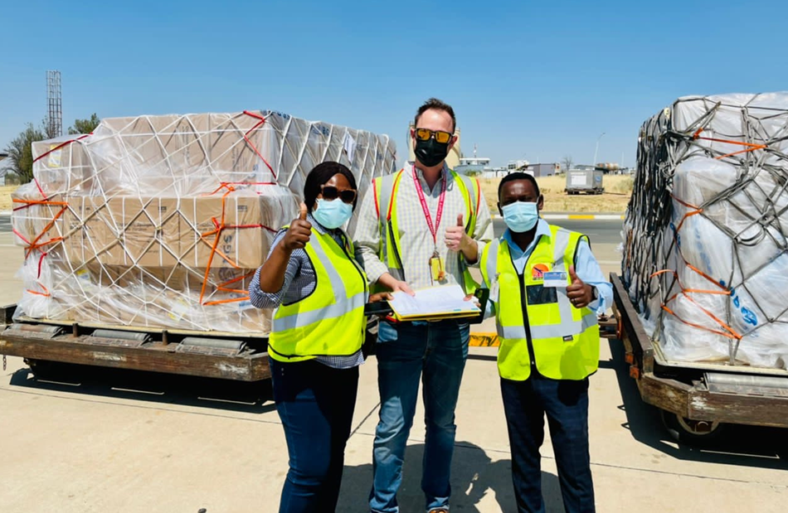
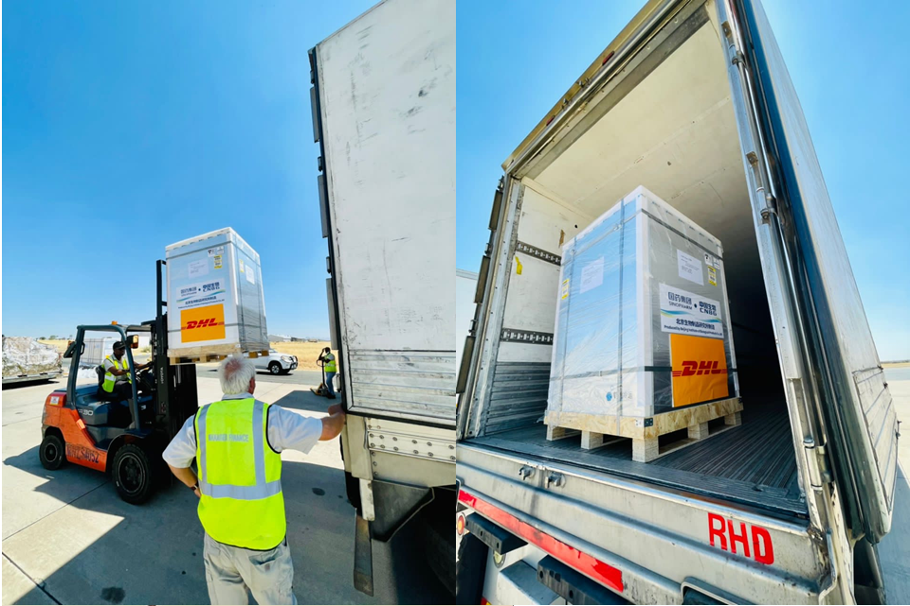
Vaccines for Hope Summary of recent initiatives
Payment for transport and insurance for 350 000 doses of Sinopharm and 500 000 syringes from Beijing to Windhoek (September 2021)
Payment for vaccination site operations:
Drive Through Vaccination Site (moved to Wanderers)
OmniCare Trust
UNAM Cares (multiples sites across Namibia)

Slide 13
Vaccines for Hope Vaccine statistics
Vaccinations by clinic / site
Vaccine choice (September 2021)
LPPH and Rhino Park no longer operational given low volumes
J&J seeing strong uptake, particularly in Youth – only available from mid Sept

Slide 14
Conclusion
NaSIA appreciates all its key stakeholders (particularly Namfisa and the Ministry of Finance) for their willingness to engage with the savings and investments industry on matters of policy and regulation to ensure that the savings and investment industry remains relevant and sustainable in the interest of Namibia.

Slide 15
THANK YOU

